Slide 1


Modeling acid rain pH variations in India End Semester Project Presentation Environmental Reaction Modelling (CE-520)
Course Instructor – Dr. Harshad Vijay Kulkarni
Presented by – Anand Prabhakar
Roll no.- DD23017
School – SCENE
Institute – IIT Mandi
Presentation date– 22nd. May, 2024

Slide 2

Contents
Objective
Introduction : Acid rain
Data Source
Data handling
Data information
Assumptions
Methodology ( pH calculations and vizualizations)
Variability in result w.r.t. actual data
Result
Conclusion
References

Slide 3
Objective
To model the acid rain precipitation data to obtain pH and various parameters using the models namely VMINTEQ V3.1 and Geochemist workbench (GWB Essentials 2023)
To visualize the results obtained

Slide 4
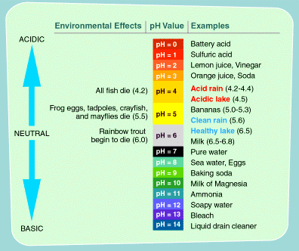
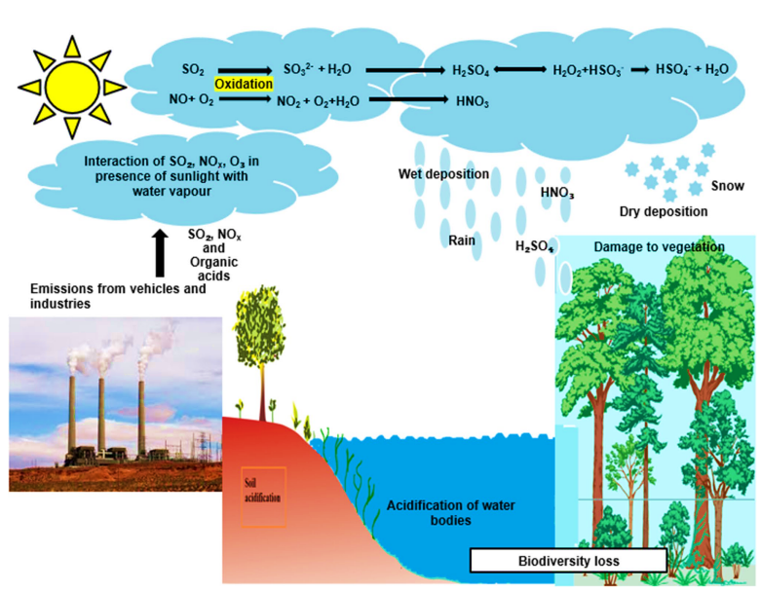
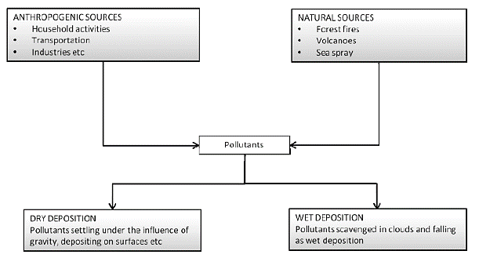
Introduction : Acid rain
pH < 5.6, implies acid rain
(US EPA)
(Prakash et al., 2022)
Acid rain = wet deposition
Lakes, soil, bedrock can neutralize natural acids.
Without any pollutants, pH ~ 5.6 (ambient conditions)
The pH can vary from 3 to 8 (and even more in worse condition)
Can result in degradation of structures, bioaccumulation, etc.
(Abbasi et al., 2013)

Slide 5
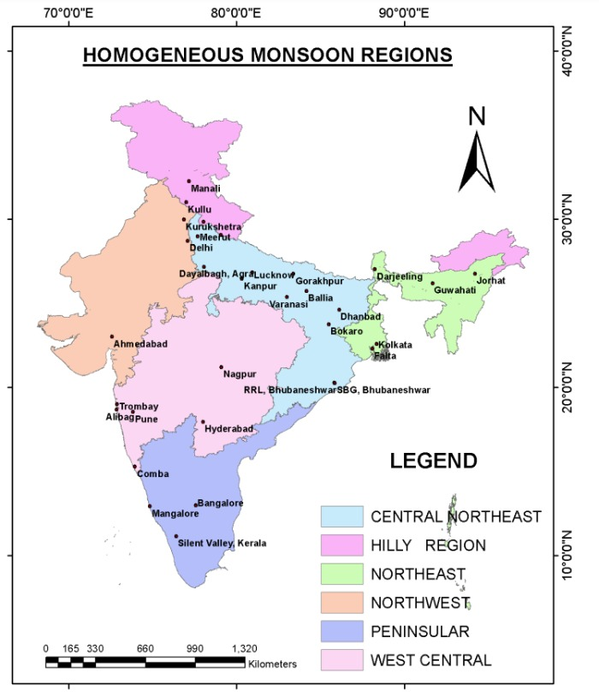
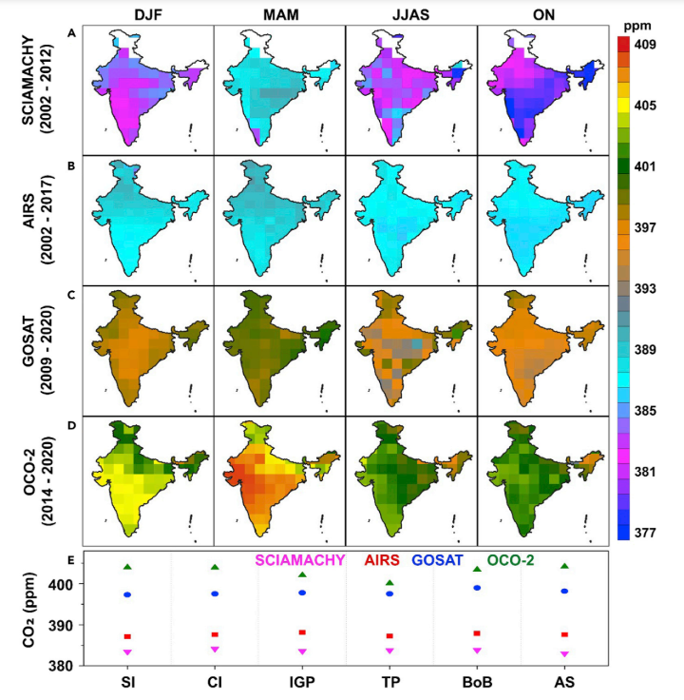

Data Source
For precipitation data – Research paper titled, “Chemical characteristics and trends of indian summer monsoon rainfall: A review. Aerosol and Air Quality Research., AAQR”, by Majumdar, A., Samanta, D. and Das, R., 2022. [study area – Indian subcontinent (CNE, HILLY, NE, NW, PENINSULA, & WC)]
For SO₂ – Sulfur dioxide (SO₂) concentration in ambient air in selected cities in India from 2001 to 2021, (Statista Search Department, 2024)
For CO₂ – Research paper titled, “The increasing atmospheric CO2 over India: Comparison to global trends” by J. Kuttippurath and others, 2022{involves use of satellite data SCIAMACHY SCIA(2002-2012), AIRS (2002-2007), GOSAT (2009-2020) and OCO-2 (2014-2020)}
(Majumdar et al., (2022), Kuttippurath et al., (2022), and Statista Search Department, (2024) )

Slide 6
Data handling
Units of species concentration data were converted to mg/L from μeq./L for usage in models
meq/L = [(mg/L x molar mass)/ valency]
and, meq/L = μeq./L x 10⁻³
Replaced missing data with that of average concentration value of the same region
Ideal gas equation used for conversion of partial pressure of CO₂ and SO₂ from ppm to atm.
i.e. PV = nRT P = (n/V) x R x T or
P = CRT
Where, P = partial pressure of gas
C = concentration of species
T = temperature in kelvin
R = Universal gas constant
Unit conversion were taken care of : use of mg, L, atm., K, mol.
Only those year data were taken into account which has corresponding partial pressure in same year (17 out of 57 samples used in VMINTEQ)

Slide 7
Data information
In entire dataset of India : total 52 precipitation data acidic out of 57, with mean pH of 5.96 (acidic precipitation) and 6.06 (entire dataset)
In region 1 : 6 out of 7 entries indicated acidic precipitation with mean of 6.16
In region 2 : 3 out of 4 entries indicated acidic precipitation with mean of 5.67
In region 3 : 18 out of 21 entries indicated acidic precipitation with mean of 5.99
In region 4 : 6 out of 6 entries indicated acidic precipitation with mean of 5.65
In region 5 : 5 out of 5 entries indicated acidic precipitation with mean of 5.43
In region 6 : 14 out of 14 entries indicated acidic precipitation with mean of 6.21

Slide 8
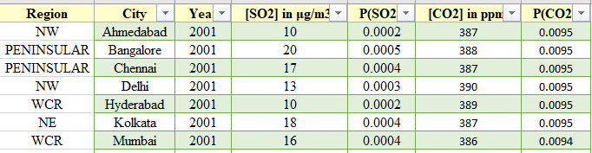
Assumptions
Only SO2 and CO2 gaseous partial pressure taken into account
Various conditions :
Ideal (when there are no pollutants addition and gas-particle interaction),
Meteoric condition and
Polluted condition (when CO2 and SO2 partial pressure is there in the atmosphere)
For VMINTEQ and PHREEQ-C unit used for conc. is mg/L whereas for GWB it is μeq/L
From (2001-2004) - July-sept Monsoon (JJAS), AIRS (2002-2017 data)
From (2008-2009) - July-sept Monsoon (JJAS), GOSAT (2009-2020 data)
From (2012-2021) - July-sept Monsoon (JJAS), OCO-2 (2014-2020 data) {as per paper lowest among all seasons}
Usage of the average partial pressure data for the values of region wise missing partial pressure data. (i.e. for the HILLY region average value is used)

Slide 9

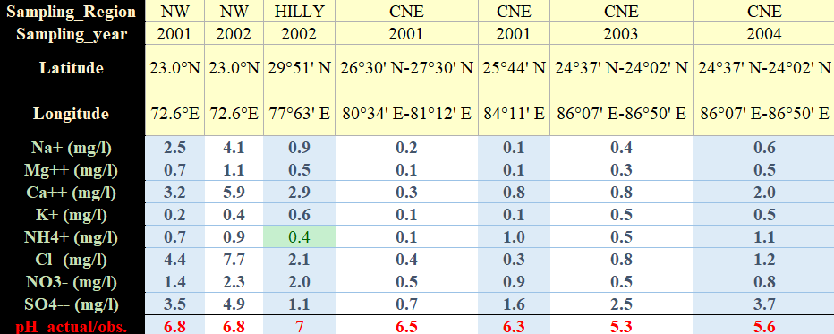
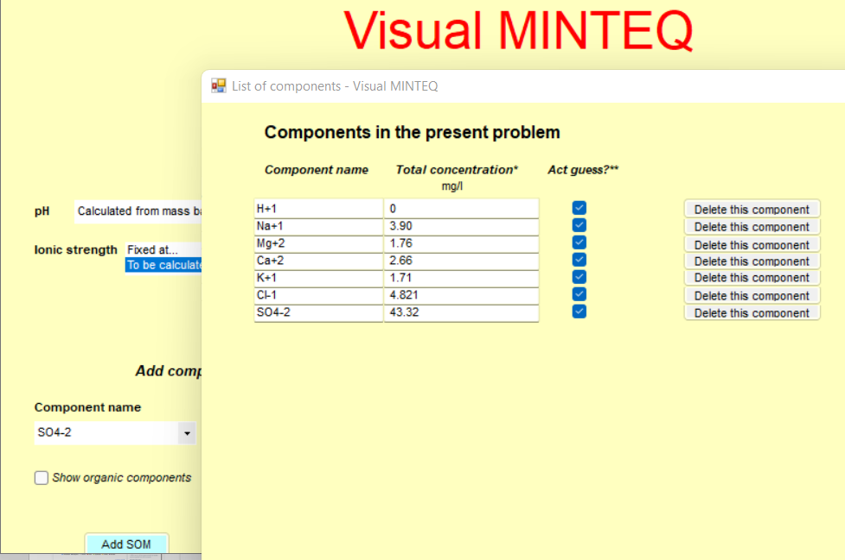
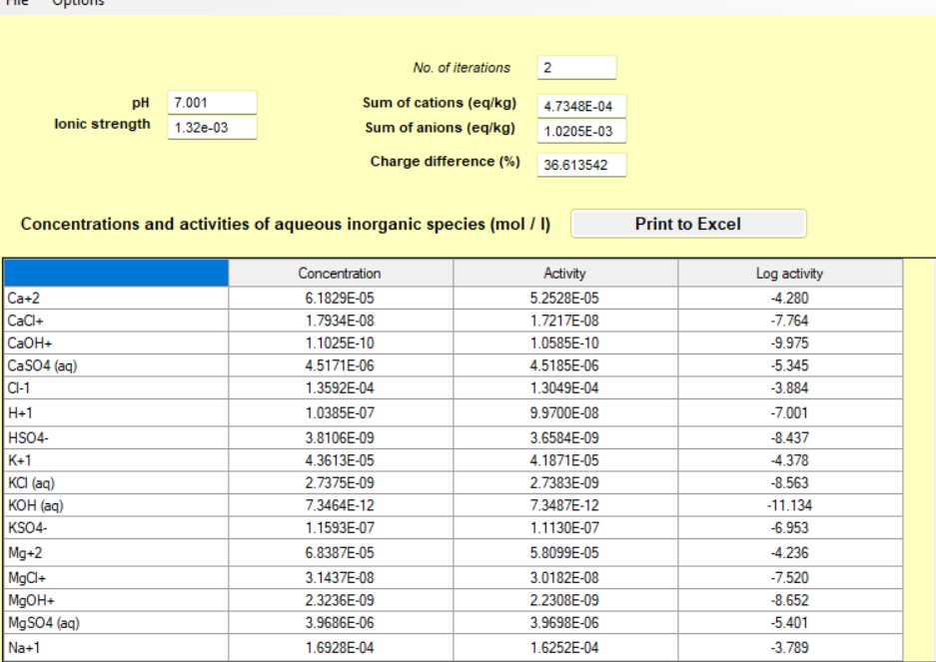
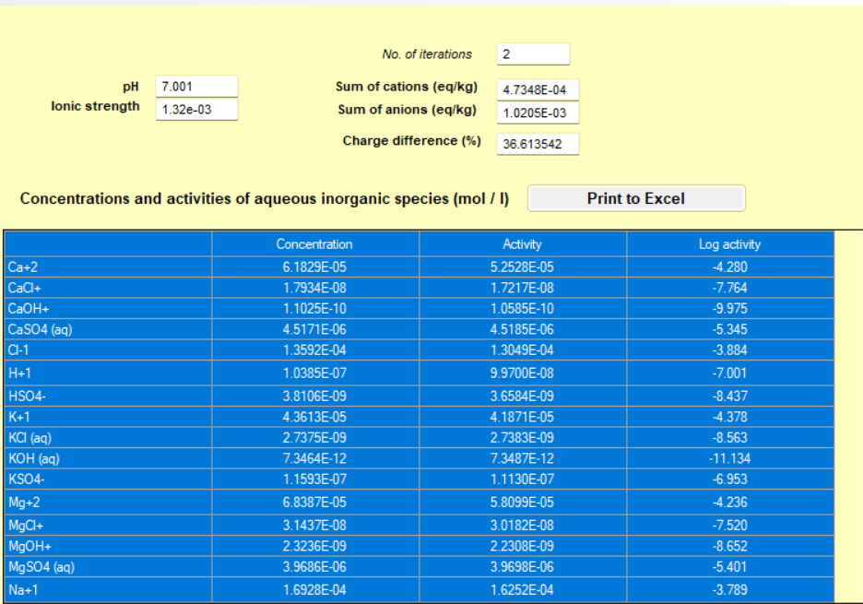
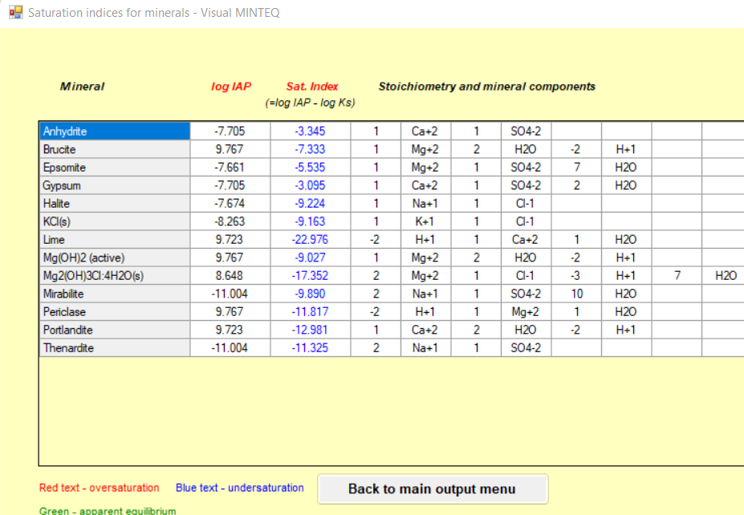
Methodology - pH calculation using VMINTEQ
We have conc. In ueq./L which I converted in mg/L to input into the model
Species are added in the table under ambient, meteoric and under polluted condition.
Species conc. Data in mg/L
Species addition
pH calculation by model under ambient, meteoric and polluted environment is noted and is verified against actual pH in the data
(VMINTEQ)
Mineral precipitation data
Species at this pH;

Slide 10
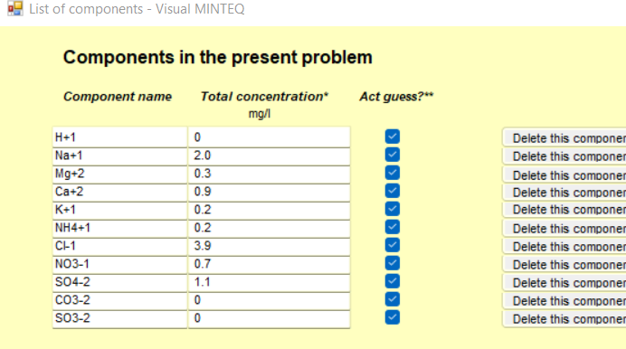
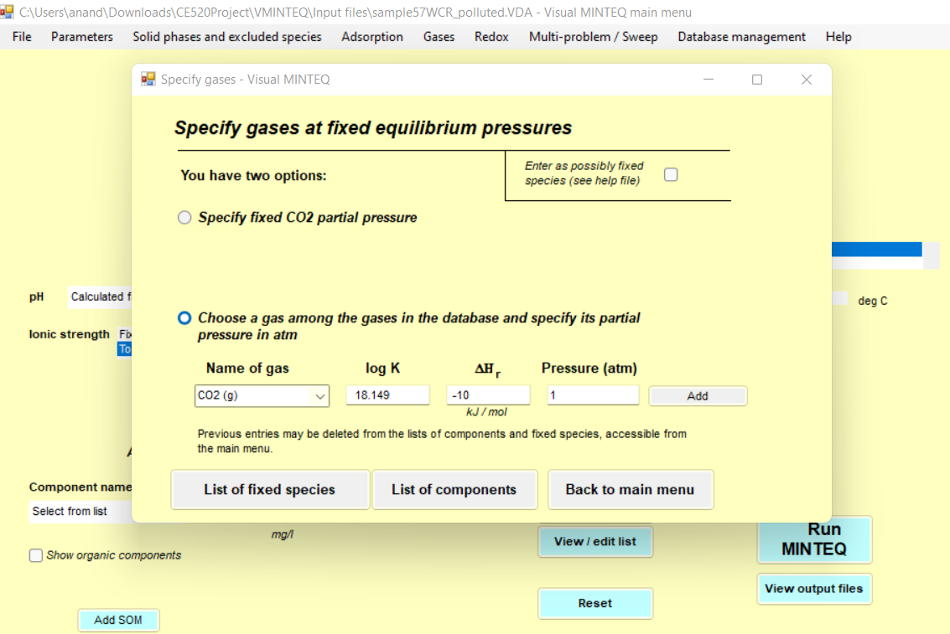
Methodology - pH calculation using VMINTEQ contd..
For meteoric condition 1 atm. of CO2 is added as the gaseous species partial pressure menu.
For the Polluted condition the partial pressure of CO₂ and SO₂ is introduced in the model.
We have in the model : CO₂ and SO₂ gas
However, in real there are many atmospheric gases present like NO₂, NO, O₃, etc.
(VMINTEQ)

Slide 11
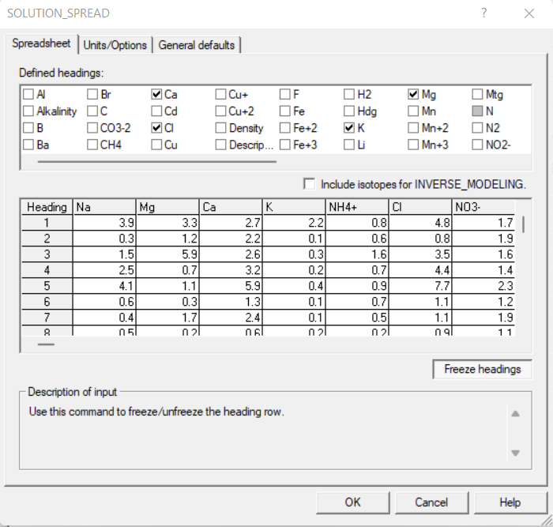
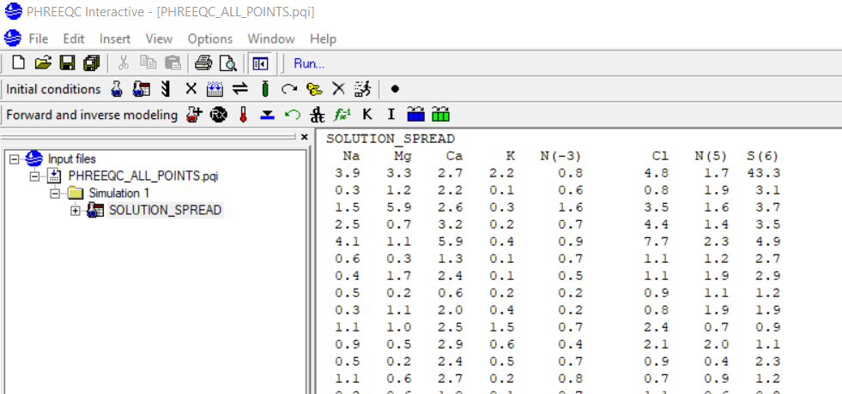
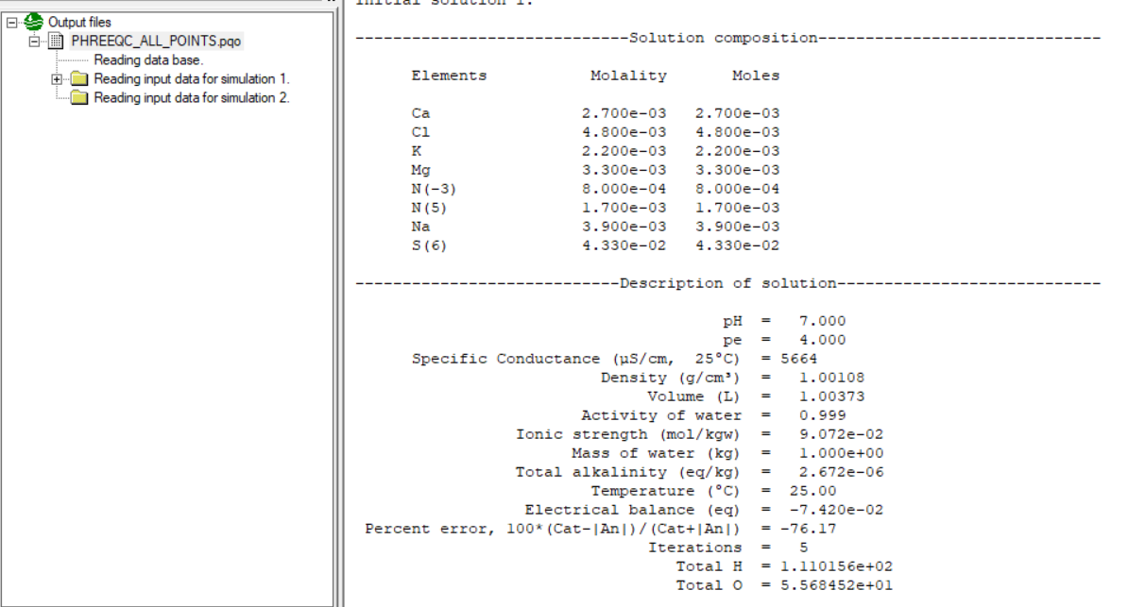
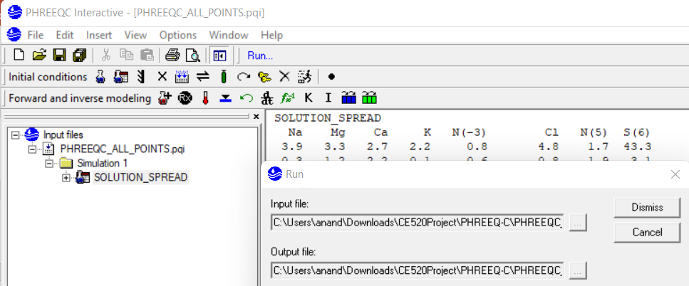
Methodology - pH calculation using PHREEQC
This model gave the constant pH value of 7.0 for all the samples run.
Solution preparation in bulk
Input in form of solution spreadsheet
Model output
Running the model
(PHREEQC)

Slide 12
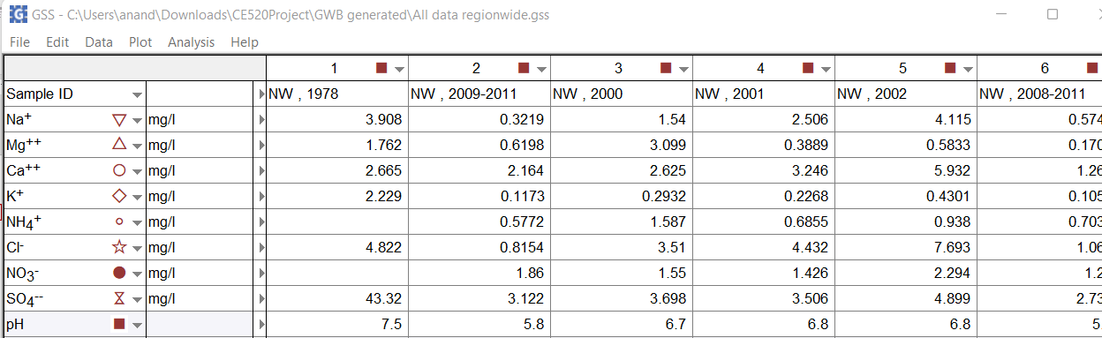
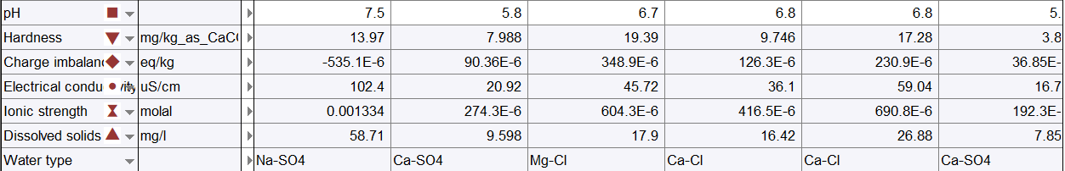
Methodology - pH calculation using GWB
Analysis > Calculate with Spec8
Choose the parameter to calculate
Model input through GWB spreadsheet
Parameters as model output
This model didn’t gave pH values by calculating through Spec8
Other parameters are calculated
(GWB, 2023)

Slide 13
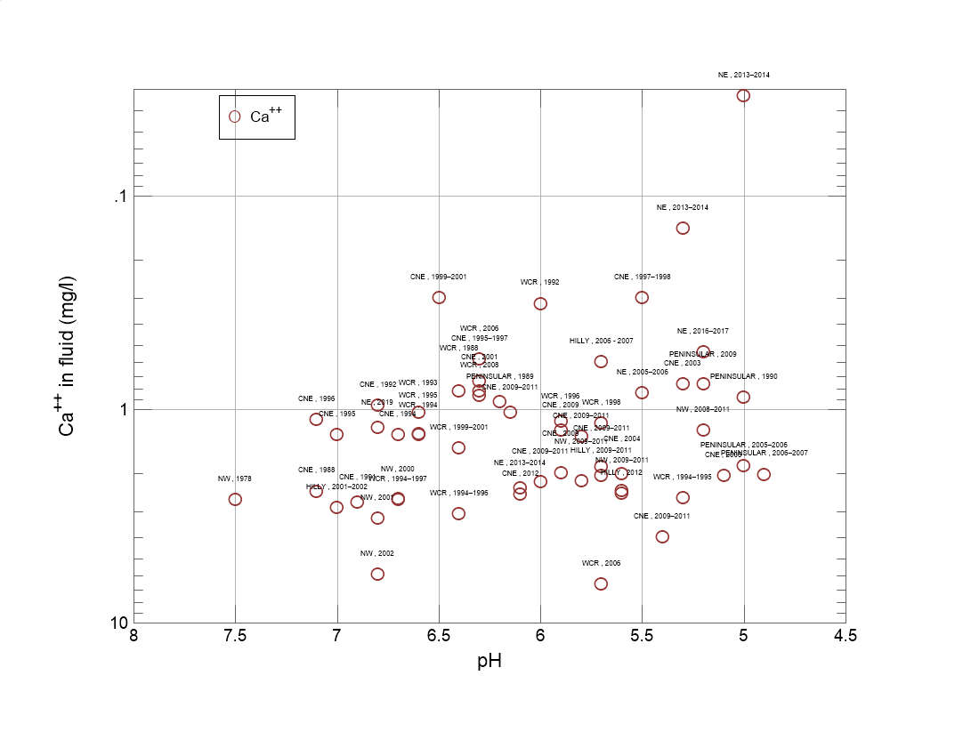
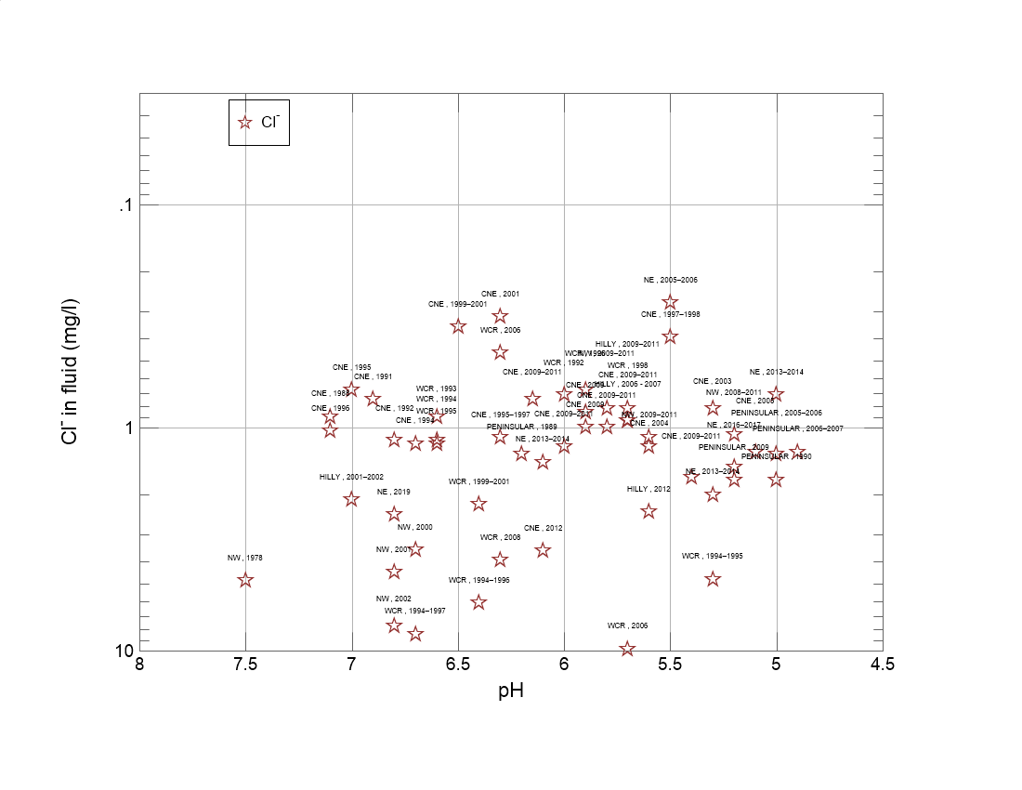
Methodology – Visualization using GWB
Analysis > Calculate with Spec8
Choose the parameter to calculate
(GWB, 20023)

Slide 14
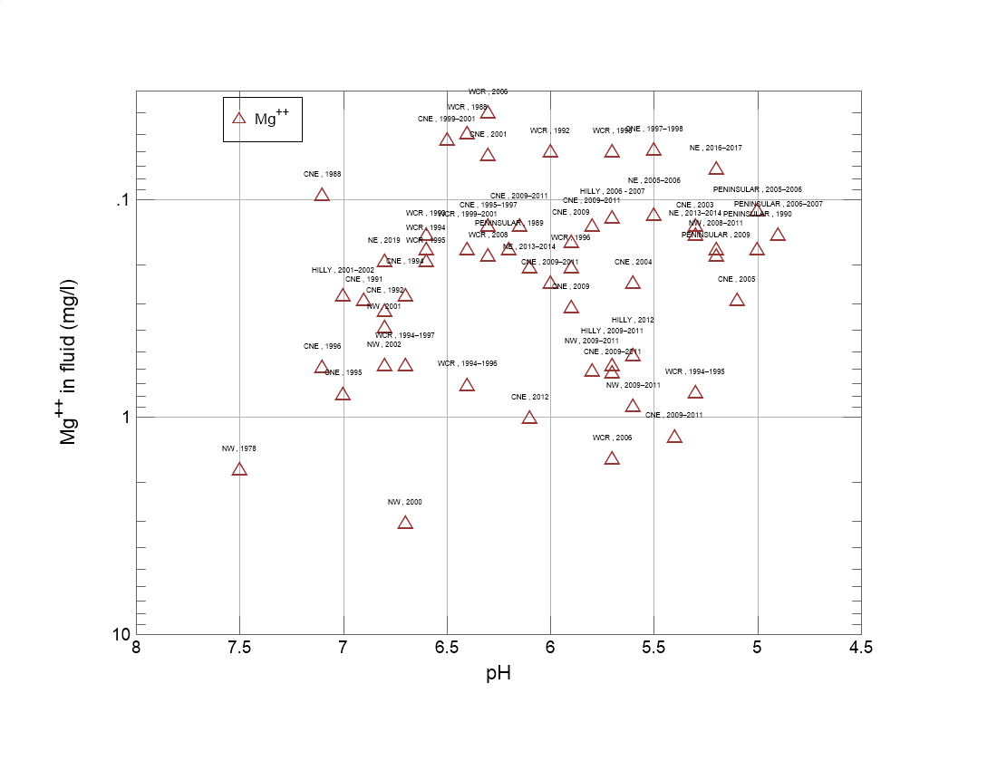
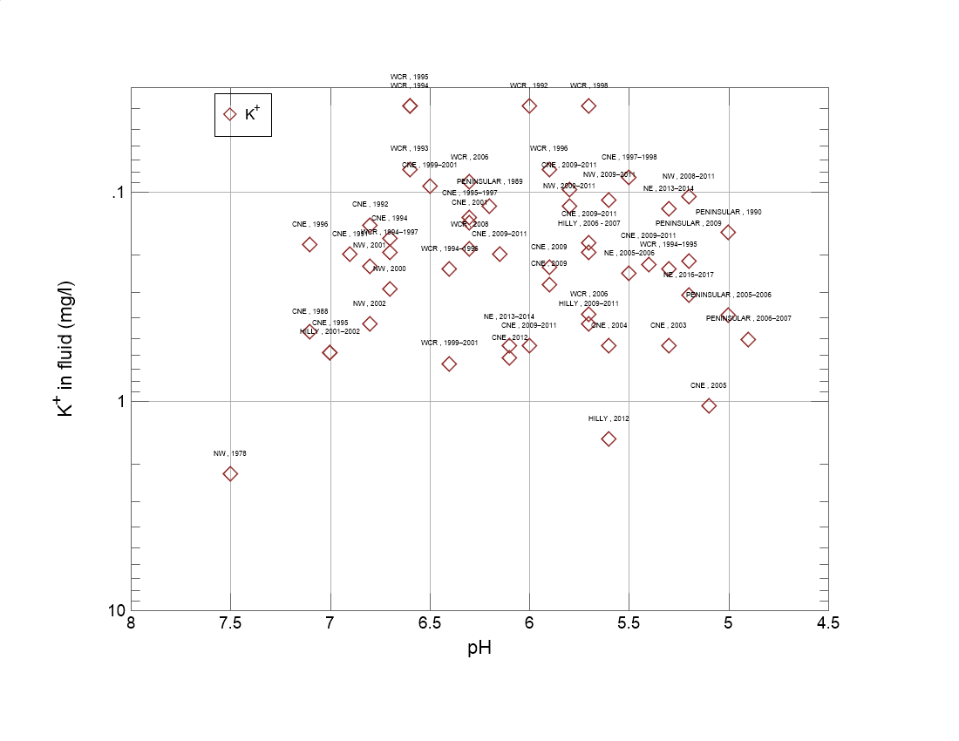
Methodology – Visualization using GWB
(GWB, 20023)

Slide 15
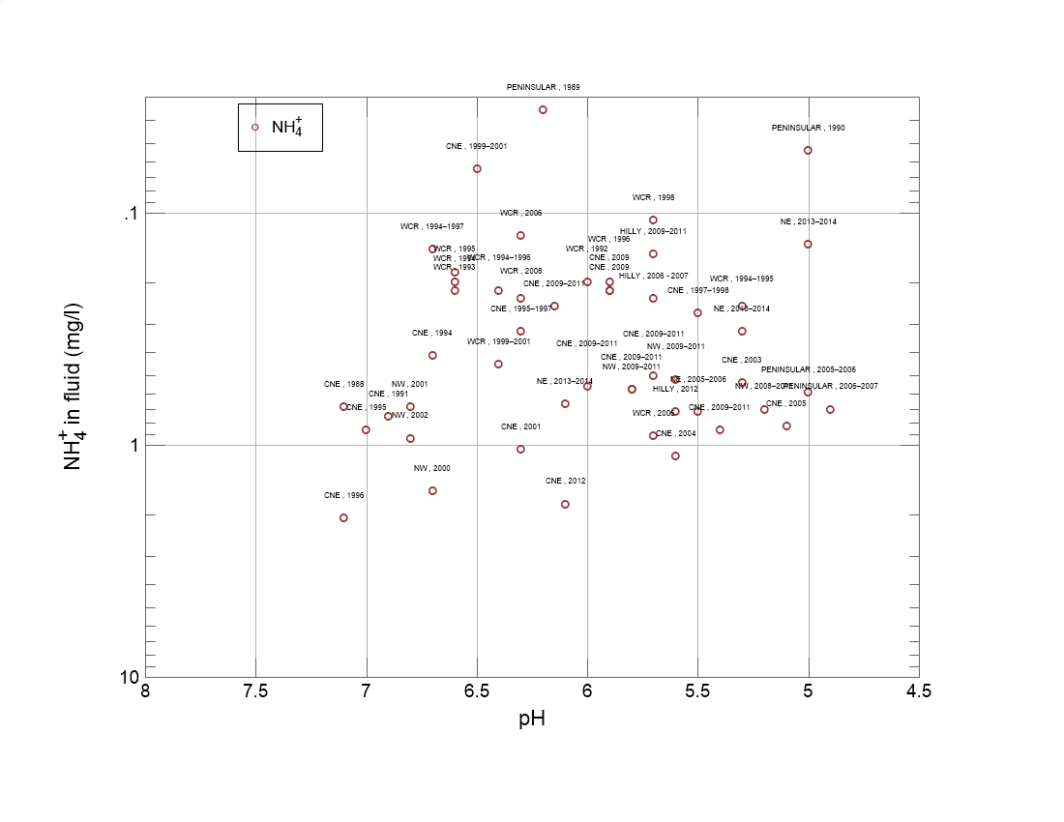
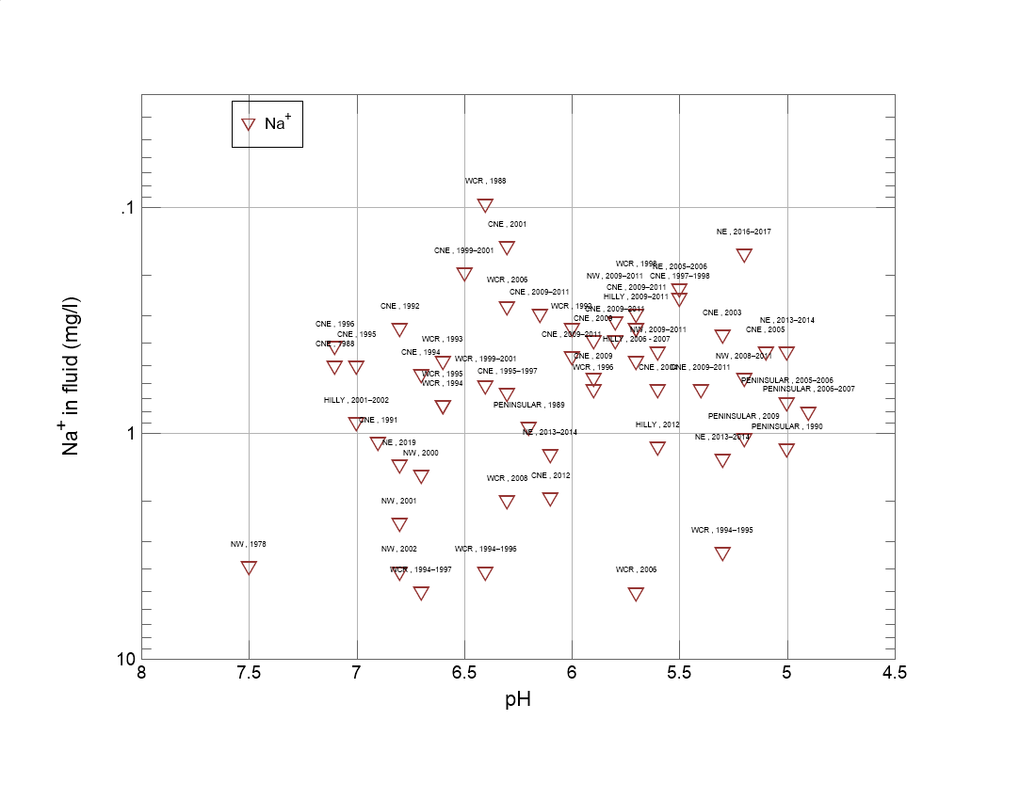
Methodology – Visualization using GWB
(GWB, 20023)

Slide 16
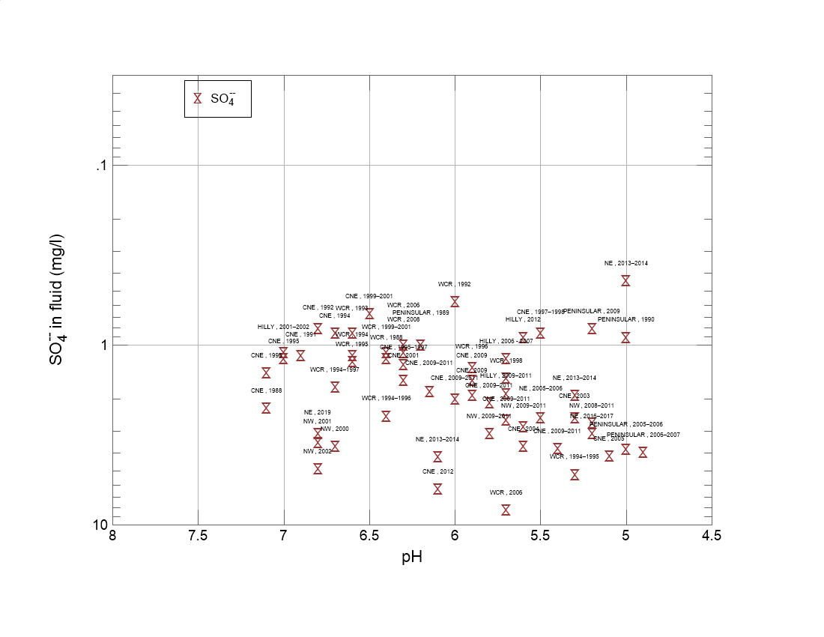
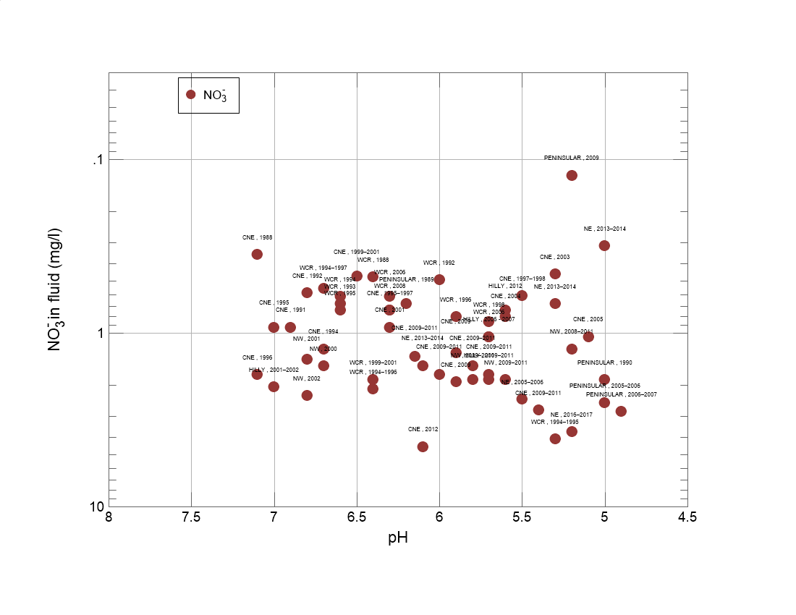
Methodology – Visualization using GWB

Slide 17
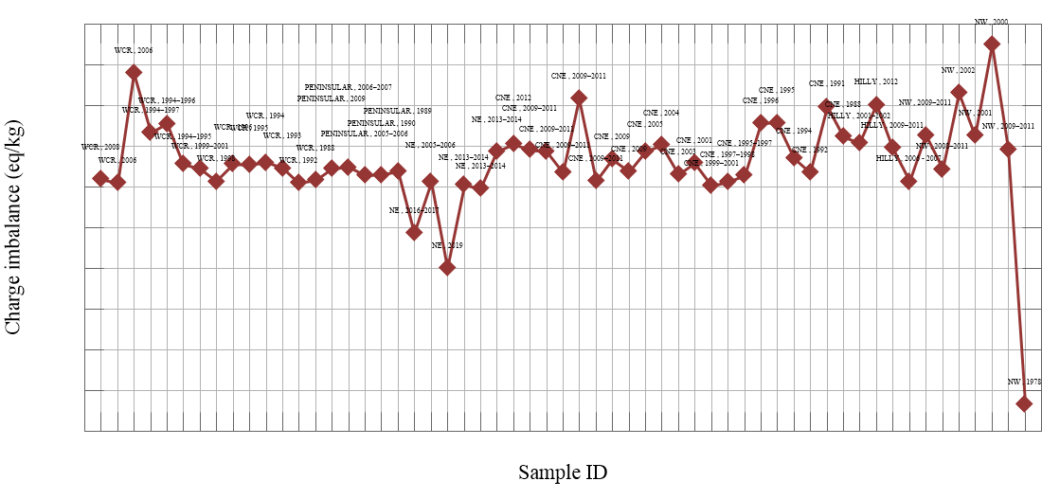
Methodology – Visualization using GWB

Slide 18
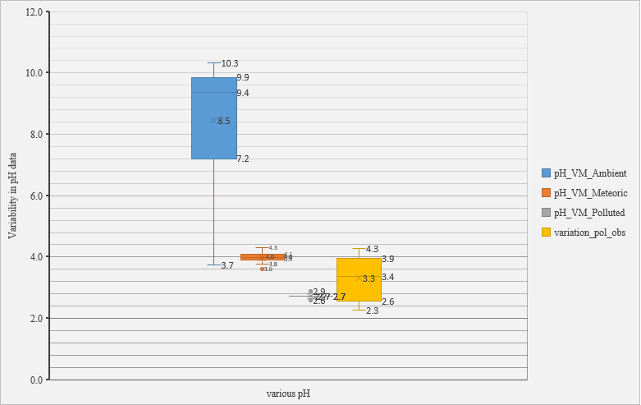
Variability in result w.r.t. actual data
Ambient pH data in this case falls in highly basic range i.e. 7.2 – 9.9
Meteoric pH varied b/w 3.9 and 4.1
Under polluted most lies at 2.7
In actual condition, pH ranged b/w, 2.6 to 3.9

Slide 19
Results (VMINTEQ)
Sampling_Region | Sampling_year | Latitude | Longitude | pH_actual/obs. | pH_VM_Ambient | pH_VM_Meteoric | pH_VM_Polluted | variation_pol_obs
NW | 2001 | 23.0°N | 72.6°E | 6.8 | 10.0 | 4.2 | 2.7 | 4.1
NW | 2002 | 23.0°N | 72.6°E | 6.8 | 10.3 | 4.3 | 2.6 | 4.2
HILLY | 2002 | 29°51' N | 77°63' E | 7.0 | 10.1 | 4.2 | 2.7 | 4.3
CNE | 2001 | 26°30' N-27°30' N | 80°34' E-81°12' E | 6.5 | 8.7 | 3.9 | 2.7 | 3.8
CNE | 2001 | 25°44' N | 84°11' E | 6.3 | 9.4 | 4.0 | 2.7 | 3.6
CNE | 2003 | 24°37' N-24°02' N | 86°07' E-86°50' E | 5.3 | 9.4 | 4.0 | 2.7 | 2.6
CNE | 2004 | 24°37' N-24°02' N | 86°07' E-86°50' E | 5.6 | 9.8 | 4.1 | 2.7 | 2.9
CNE | 2009 | 25.2677° N | 82.9913° E | 5.9 | 9.3 | 4.0 | 2.7 | 3.2
CNE | 2009 | 25.3255° N | 82.9952° E | 5.9 | 9.9 | 4.1 | 2.7 | 3.2
NE | 2014 | 22.33° N | 88.20° E | 6.1 | 9.8 | 4.1 | 2.7 | 3.4
NE | 2014 | 22.18° N | 88.06° E | 5.3 | 5.7 | 3.9 | 2.7 | 2.6
NE | 2014 | 27°01′ N | 88°15′ E | 5.0 | 5.0 | 3.9 | 2.7 | 2.3
NE | 2019 | 22°29′57.53'' N | 88°22′18.66'' E | 6.8 | 3.7 | 3.6 | 2.7 | 4.1
NE | 2017 | 26°11′14″ N | 91°41′30″ E | 5.2 | 4.1 | 3.8 | 2.9 | 2.3
PENINSULAR | 2009 | 12.9141° N | 74.8560° E | 5.2 | 9.7 | 4.0 | 2.6 | 2.6
WCR | 2001 | 17.57° N | 78.5° E | 6.4 | 9.5 | 4.0 | 2.6 | 3.8
WCR | 2008 | 15°16′49″ N | 73°57′37″ E | 6.3 | 9.3 | 4.0 | 2.7 | 3.6
 |  |  | Average | 6.0 | 8.5 | 4.0 | 2.7 | 3.3
 |  |  | Min. | 5 | 3.731 | 3.608 | 2.579 | 2.27
 |  |  | Max. | 7 | 10.32 | 4.307 | 2.88 | 4.27
(GWB, 20023)

Slide 20
Results (GWB)
Sample ID |  | NW , 1978 | NW , 2009-2011 | NW , 2000 | NW , 2001 | NW , 2002 | NW , 2008-2011 | NW , 2009-2011 | HILLY , 2006 - 2007 | HILLY , 2009-2011 | HILLY , 2012 | HILLY , 2001-2002
Na+ | mg/l | 3.908 | 0.3219 | 1.54 | 2.506 | 4.115 | 0.5747 | 0.4368 | 0.4828 | 0.3448 | 1.149 | 0.8966
Mg++ | mg/l | 1.762 | 0.6198 | 3.099 | 0.3889 | 0.5833 | 0.1701 | 0.8993 | 0.1215 | 0.5833 | 0.5226 | 0.2795
Ca++ | mg/l | 2.665 | 2.164 | 2.625 | 3.246 | 5.932 | 1.263 | 2.405 | 0.6012 | 2.044 | 2.485 | 2.906
K+ | mg/l | 2.229 | 0.1173 | 0.2932 | 0.2268 | 0.4301 | 0.1056 | 0.1095 | 0.1955 | 0.4301 | 1.525 | 0.5865
NH4+ | mg/l |  | 0.5772 | 1.587 | 0.6855 | 0.938 | 0.7035 | 0.5231 | 0.2345 | 0.1515 | 0.7215
Cl- | mg/l | 4.822 | 0.8154 | 3.51 | 4.432 | 7.693 | 1.064 | 1.099 | 0.9218 | 0.8154 | 2.375 | 2.092
NO3- | mg/l |  | 1.86 | 1.55 | 1.426 | 2.294 | 1.24 | 1.86 | 1.054 | 1.86 | 0.7441 | 2.046
SO4-- | mg/l | 43.32 | 3.122 | 3.698 | 3.506 | 4.899 | 2.738 | 2.882 | 1.201 | 1.873 | 0.9125 | 1.105
pH |  | 7.5 | 5.8 | 6.7 | 6.8 | 6.8 | 5.2 | 5.6 | 5.7 | 5.7 | 5.6 | 7
Hardness | mg/kg_as_CaCO3 | 13.97 | 7.988 | 19.39 | 9.746 | 17.28 | 3.87 | 9.748 | 2.01 | 7.536 | 8.391 | 8.442
Charge imbalance | eq/kg | -5.35E-04 | 9.04E-05 | 3.49E-04 | 1.26E-04 | 2.31E-04 | 3.69E-05 | 1.24E-04 | 1.10E-05 | 9.28E-05 | 1.99E-04 | 1.07E-04
Electrical conductivity | uS/cm | 102.4 | 20.92 | 45.72 | 36.1 | 59.04 | 16.77 | 23.01 | 9.796 | 17.41 | 25.04 | 21.17
Ionic strength | molal | 0.001334 | 2.74E-04 | 6.04E-04 | 4.17E-04 | 6.91E-04 | 1.92E-04 | 3.09E-04 | 1.06E-04 | 2.33E-04 | 2.91E-04 | 2.64E-04
Water type |  | Na-SO4 | Ca-SO4 | Mg-Cl | Ca-Cl | Ca-Cl | Ca-SO4 | Ca-SO4 | Ca-Cl | Ca-SO4 | Ca-Cl | Ca-Cl
Dissolved solids | mg/l | 58.71 | 9.598 | 17.9 | 16.42 | 26.88 | 7.858 | 10.21 | 4.812 | 8.103 | 10.44 | 9.911
(GWB, 20023)

Slide 21
Results (GWB)
CNE , 1988 | CNE , 1991 | CNE , 1992 | CNE , 1994 | CNE , 1995 | CNE , 1996 | CNE , 1995-1997 | CNE , 1997-1998 | CNE , 1999-2001 | CNE , 2001 | CNE , 2003 | CNE , 2004 | CNE , 2005 | CNE , 2009 | CNE , 2009 | CNE , 2009-2011 | CNE , 2009-2011 | CNE , 2009-2011 | CNE , 2009-2011 | CNE , 2009-2011 | CNE , 2012
0.5058 | 1.104 | 0.3448 | 0.5518 | 0.5058 | 0.4138 | 0.6667 | 0.2529 | 0.1954 | 0.1494 | 0.3678 | 0.6437 | 0.4368 | 0.5747 | 0.3908 | 0.2989 | 0.6437 | 0.3908 | 0.3448 | 0.4598 | 1.931
0.096 | 0.2917 | 0.3281 | 0.2795 | 0.7899 | 0.5955 | 0.1337 | 0.05955 | 0.05347 | 0.06319 | 0.1337 | 0.243 | 0.2917 | 0.158 | 0.316 | 0.1337 | 1.24 | 0.1337 | 0.6319 | 0.243 | 1.021
2.425 | 2.745 | 0.9619 | 1.323 | 1.323 | 1.122 | 0.7415 | 0.3006 | 0.3006 | 0.8216 | 0.7615 | 2.004 | 2.044 | 1.263 | 1.984 | 1.042 | 3.988 | 1.343 | 1.864 | 2.184 | 2.505
0.4692 | 0.1994 | 0.1447 | 0.1681 | 0.5865 | 0.1799 | 0.1329 | 0.08602 | 0.09384 | 0.1408 | 0.5474 | 0.5474 | 1.056 | 0.2307 | 0.2776 | 0.1994 | 0.2229 | 0.09775 | 0.1759 | 0.5474 | 0.6256
0.6855 | 0.7576 |  | 0.4149 | 0.8658 | 2.074 | 0.3247 | 0.2706 | 0.06494 | 1.046 | 0.5411 | 1.118 | 0.8298 | 0.2165 | 0.2165 | 0.2525 | 0.8658 | 0.5772 | 0.5051 | 0.5592 | 1.804
0.8863 | 0.7445 | 1.134 | 1.17 | 0.6736 | 1.028 | 1.099 | 0.39 | 0.351 | 0.3155 | 0.8154 | 1.205 | 1.276 | 0.9927 | 0.8509 | 0.7445 | 1.666 | 0.9927 | 0.9218 | 1.205 | 3.545
0.3534 | 0.9301 | 0.589 | 1.24 | 0.9301 | 1.736 | 0.7441 | 0.6138 | 0.4712 | 0.9301 | 0.4588 | 0.8061 | 1.054 | 1.302 | 1.922 | 1.364 | 2.79 | 1.55 | 1.736 | 1.736 | 4.526
2.257 | 1.153 | 0.8165 | 0.8645 | 1.201 | 1.441 | 1.297 | 0.8645 | 0.6724 | 1.585 | 2.546 | 3.698 | 4.179 | 1.585 | 1.921 | 1.825 | 3.794 | 2.113 | 2.642 | 2.017 | 6.388
7.1 | 6.9 | 6.8 | 6.7 | 7 | 7.1 | 6.3 | 5.5 | 6.5 | 6.3 | 5.3 | 5.6 | 5.1 | 5.9 | 5.9 | 6.15 | 5.4 | 5.8 | 5.7 | 6 | 6.1
6.477 | 8.088 | 3.768 | 4.473 | 6.583 | 5.275 | 2.412 | 0.9999 | 0.9747 | 2.321 | 2.462 | 6.029 | 6.331 | 3.82 | 6.281 | 3.165 | 15.13 | 3.92 | 7.286 | 6.48 | 10.5
1.24E-04 | 1.97E-04 | 3.53E-05 | 6.96E-05 | 1.58E-04 | 1.56E-04 | 2.85E-05 | 9.24E-06 | 2.41E-06 | 5.76E-05 | 2.57E-05 | 1.00E-04 | 7.83E-05 | 3.71E-05 | 6.64E-05 | 1.42E-05 | 2.13E-04 | 3.26E-05 | 8.38E-05 | 9.04E-05 | 1.03E-04
18.04 | 19.46 | 9.672 | 13.56 | 17.34 | 21.93 | 11.07 | 5.915 | 4.384 | 11.8 | 13.2 | 23.11 | 23.96 | 13.08 | 16.41 | 11.76 | 34.5 | 15.13 | 19.34 | 19.4 | 46.7
2.27E-04 | 2.51E-04 | 1.22E-04 | 1.60E-04 | 2.16E-04 | 2.33E-04 | 1.22E-04 | 6.26E-05 | 4.95E-05 | 1.25E-04 | 1.47E-04 | 2.72E-04 | 2.85E-04 | 1.55E-04 | 2.11E-04 | 1.39E-04 | 4.65E-04 | 1.74E-04 | 2.50E-04 | 2.34E-04 | 5.26E-04
Ca-SO4 | Ca-SO4 | Ca-Cl | Ca-Cl | Ca-SO4 | NH4-SO4 | Ca-Cl | NH4-SO4 | Ca-SO4 | NH4-SO4 | Ca-SO4 | Ca-SO4 | Ca-SO4 | Ca-SO4 | Ca-SO4 | Ca-SO4 | Ca-SO4 | Ca-SO4 | Ca-SO4 | Ca-SO4 | Ca-SO4
7.678 | 7.925 | 4.32 | 6.011 | 6.875 | 8.591 | 5.139 | 2.838 | 2.203 | 5.052 | 6.171 | 10.27 | 11.17 | 6.322 | 7.879 | 5.86 | 15.21 | 7.198 | 8.821 | 8.953 | 22.35
(GWB, 20023)

Slide 22
Results (GWB)
NE , 2013-2014 | NE , 2013-2014 | NE , 2013-2014 | NE , 2019 | NE , 2005-2006 | NE , 2016-2017 | PENINSULAR , 1989 | PENINSULAR , 1990 | PENINSULAR , 2005-2006 | PENINSULAR , 2006-2007 | PENINSULAR , 2009
1.241 | 1.31 | 0.4368 | 1.379 | 0.2299 | 0.1609 | 0.9426 | 1.172 | 0.7357 | 0.8046 | 1.058
0.2066 | 0.1458 | 0.01337 | 0.1944 | 0.1191 | 0.07292 | 0.1701 | 0.1701 | 0.113 | 0.1458 | 0.1823
2.345 | 0.1423 | 0.03407 | 1.222 | 0.8417 | 0.5411 | 0.9218 | 0.8818 | 1.844 | 2.024 | 0.7615
0.5474 | 0.1212 | 0.01564 |  | 0.2463 | 0.3128 | 0.1173 | 0.1564 | 0.391 | 0.5083 | 0.215
0.6674 | 0.3247 | 0.1371 |  | 0.7215 |  | 0.03608 | 0.05411 | 0.5953 | 0.7035
1.418 | 1.985 | 0.7091 | 2.446 | 0.273 | 1.489 | 1.312 | 1.702 | 1.312 | 1.276 | 1.702
1.55 | 0.6821 | 0.3162 | 12.52 | 2.418 | 3.72 | 0.6821 | 1.86 | 2.542 | 2.852 | 0.124
4.227 | 1.921 | 0.4419 | 3.122 | 2.546 | 3.122 | 1.009 | 0.9125 | 3.842 | 3.986 | 0.8165
6.1 | 5.3 | 5 | 6.8 | 5.5 | 5.2 | 6.2 | 5 | 5 | 4.9 | 5.2
6.734 | 0.9596 | 0.1407 | 3.868 | 2.603 | 1.658 | 3.014 | 2.914 | 5.091 | 5.677 | 2.663
8.63E-05 | -9.84E-06 | -4.52E-06 | -2.00E-04 | 8.43E-06 | -1.20E-04 | 3.72E-05 | 1.91E-05 | 1.84E-05 | 3.51E-05 | 3.77E-05
25.5 | 13.63 | 4.33 | 31.89 | 14.31 | 15.35 | 11.07 | 13.63 | 22.36 | 24.3 | 10.84
3.06E-04 | 1.32E-04 | 3.82E-05 | 3.08E-04 | 1.56E-04 | 1.57E-04 | 1.28E-04 | 1.45E-04 | 2.57E-04 | 2.80E-04 | 1.21E-04
Ca-SO4 | Na-Cl | Na-Cl | Ca-NO3 | Ca-SO4 | Ca-SO4 | Ca-Cl | Na-Cl | Ca-SO4 | Ca-SO4 | Na-Cl
12.2 | 6.633 | 2.104 | 20.89 | 7.395 | 9.419 | 5.19 | 6.909 | 11.37 | 12.3 | 4.859
(GWB, 20023)

Slide 23
Results (GWB)
WCR , 1988 | WCR , 1992 | WCR , 1993 | WCR , 1994 | WCR , 1995 | WCR , 1996 | WCR , 1998 | WCR , 1999-2001 | WCR , 1994-1995 | WCR , 1994-1996 | WCR , 1994-1997 | WCR , 2006 | WCR , 2006 | WCR , 2008
0.09656 | 0.3448 | 0.4828 | 0.7587 | 0.7587 | 0.6437 | 0.2989 | 0.6207 | 3.38 | 4.115 | 5.058 | 5.081 | 0.2759 | 2
0.04983 | 0.06076 | 0.1458 | 0.1701 | 0.1944 | 0.2066 | 0.06076 | 0.1701 | 0.7778 | 0.717 | 0.5833 | 1.568 | 0.0401 | 0.1823
0.8216 | 0.3206 | 1.042 | 1.323 | 1.303 | 1.142 | 1.162 | 1.523 | 2.605 | 3.106 | 2.665 | 6.633 | 0.5812 | 0.8617
 | 0.0391 | 0.0782 | 0.0391 | 0.0391 | 0.0782 | 0.0391 | 0.6647 | 0.2346 | 0.2346 | 0.1955 | 0.3871 | 0.08993 | 0.1877
 | 0.1984 | 0.2165 | 0.1984 | 0.1804 | 0.1984 | 0.1082 | 0.451 | 0.2525 | 0.2165 | 0.1443 | 0.92 | 0.1263 | 0.2345
 | 0.7091 | 0.8863 | 1.134 | 1.17 | 0.6736 | 0.9218 | 2.198 | 4.751 | 6.062 | 8.367 | 9.75 | 0.4609 | 3.9
0.4774 | 0.496 | 0.6821 | 0.62 | 0.7441 | 0.8061 | 0.8681 | 1.86 | 4.092 | 2.108 | 0.558 | 1.054 | 0.62 | 0.7441
1.201 | 0.5763 | 0.8645 | 1.153 | 1.249 | 1.345 | 1.537 | 1.105 | 5.283 | 2.497 | 1.729 | 8.357 | 1.009 | 1.105
6.4 | 6 | 6.6 | 6.6 | 6.6 | 5.9 | 5.7 | 6.4 | 5.3 | 6.4 | 6.7 | 5.7 | 6.3 | 6.3
2.266 | 1.055 | 3.215 | 4.02 | 4.071 | 3.717 | 3.165 | 4.522 | 9.747 | 10.75 | 9.093 | 23.11 | 1.623 | 2.914
1.67E-05 | 8.03E-06 | 4.52E-05 | 5.92E-05 | 5.42E-05 | 5.52E-05 | 1.10E-05 | 4.42E-05 | 5.12E-05 | 1.55E-04 | 1.34E-04 | 2.77E-04 | 9.64E-06 | 1.79E-05
5.319 | 5.881 | 9.822 | 12.1 | 12.44 | 11.09 | 10.26 | 18.19 | 42.5 | 41.33 | 43.17 | 74.78 | 6.504 | 19.95
7.61E-05 | 6.07E-05 | 1.18E-04 | 1.48E-04 | 1.52E-04 | 1.39E-04 | 1.25E-04 | 1.94E-04 | 4.86E-04 | 4.67E-04 | 4.57E-04 | 9.12E-04 | 7.56E-05 | 1.95E-04
Ca-SO4 | Ca-Cl | Ca-Cl | Ca-Cl | Ca-Cl | Ca-SO4 | Ca-SO4 | Ca-Cl | Na-Cl | Na-Cl | Na-Cl | Ca-Cl | Ca-SO4 | Na-Cl
2.646 | 2.745 | 4.398 | 5.396 | 5.638 | 5.094 | 4.996 | 8.592 | 21.38 | 19.06 | 19.3 | 33.75 | 3.203 | 9.215
(GWB, 20023)

Slide 24
Results
Both meteoric and ambient conditions show a positive correlation with the actual pH values however there is lot of variability.
They are having good fit

Slide 25
Results
Both meteoric and ambient conditions show a negative correlation.
Difficult to comment on it.
This variability may be caused because only CO₂ and SO₂ are taken into account.
This variability can be countered by decreasing the CO₂ concentration in our case.
They are not having good fit

Slide 26
Conclusion
Large dataset of 17 samples (3 set each) generated by VMINTEQ model for various regions under varying conditions.
Dataset of all the species generated by PHREEQC (but they all show pH of 7)
GSS spreadsheet of dataset along with all the parameters calculated with Spec8 in GWB
On comparison we got average pH of 2.8 in polluted conditions with variation of around 3.9 with actual values.

Slide 27
References
Abbasi, T., Poornima, P., Kannadasan, T. and Abbasi, S.A., 2013. Acid rain: past, present, and future. International Journal of Environmental Engineering, 5(3), pp.229-272.
Acid Rain (students site), United States Environmental Protection Agency (US EPA) [https://www3.epa.gov/acidrain/education/site_students/index.html]
Acid Rain and Water, Water Science School 2019. USGS
Bisht, D.S., Tiwari, S., Srivastava, A.K., Singh, J.V., Singh, B.P. and Srivastava, M.K., 2015. High concentration of acidic species in rainwater at Varanasi in the Indo-Gangetic Plains, India. Natural Hazards, 75, pp.2985-3003.
Budhavant, K.B., Gawhane, R.D., Rao, P.S.P., Nair, H.R.C.R. and Safai, P.D., 2021. Long-term increasing trends in the wet deposition of secondary inorganic constituents in SW Indian precipitation. Air Quality, Atmosphere & Health, 14, pp.667-677.
Gacesa S, Klasnja. Water and Wastewater Technology. 1994. [https://www.usgs.gov/special-topics/water-science-school/science/acid-rain-and-water#overview]
Gupta, K.S., 10 Acid Rain.[https://ebooks.inflibnet.ac.in/esp16/chapter/acid-rain/]
Jacob, D.J., 1999. Introduction to atmospheric chemistry. Princeton university press.
Kumar, P., Yadav, S. and Kumar, A., 2014. Sources and processes governing rainwater chemistry in New Delhi, India. Natural hazards, 74, pp.2147-2162.
Majumdar, A., Samanta, D. and Das, R., 2022. Chemical characteristics and trends of indian summer monsoon rainfall: A review. Aerosol and Air Quality Research.
Kuttippurath, J., Peter, R., Singh, A. and Raj, S., 2022. The increasing atmospheric CO2 over India: Comparison to global trends. Iscience, 25(8).
Mohajan, H., 2018. Acid rain is a local environment pollution but global concern.
Mohan, M. and Kumar, S., 1998. Review of acid rain potential in India: future threats and remedial measures. Current science, pp.579-593.
Pani, B., 2007. Textbook of environmental chemistry. IK International Pvt Ltd.
pH Scale, Water Science School 2019. USGS
Prakash, J., Agrawal, S.B. and Agrawal, M., 2023. Global trends of acidity in rainfall and its impact on plants and soil. Journal of Soil Science and Plant Nutrition, 23(1), pp.398-419.
Shi, Z., Zhang, J., Xiao, Z., Lu, T., Ren, X. and Wei, H., 2021. Effects of acid rain on plant growth: A meta-analysis. Journal of Environmental Management, 297, p.113213.
Singh, A. and Agrawal, M., 2007. Acid rain and its ecological consequences. Journal of Environmental Biology, 29(1), p.15.
Singh, A.K., Mondal, G.C., Kumar, S., Singh, K.K., Kamal, K.P. and Sinha, A., 2007. Precipitation chemistry and occurrence of acid rain over Dhanbad, coal city of India. Environmental monitoring and assessment, 125, pp.99-110.
Tiwari, S., Chate, D.M., Bisht, D.S., Srivastava, M.K. and Padmanabhamurty, B., 2012. Rainwater chemistry in the North Western Himalayan Region, India. Atmospheric Research, 104, pp.128-138.
Vidaković, M., Djurić, N., Savković, P. and Babić, R., 2013. pH of precipitation in the area of the town of Bijeljina.
The Taj Mahal — under Environmental and Political Threat, Medium 2018, [https://medium.com/the-naked-architect/the-taj-mahal-under-environmental-and-political-threat-7b3b8c4b7f6f].
Acid Rain – Definition, Types, Causes, Effects, Examples., 2023, Adda-247 [https://www.adda247.com/school/acid-rain/]
Conversion Factors for Water Quality; KnowyourH2O

Slide 28
Thank you

